Slide 1

Sales Data Analysis
Unlocking Growth Through Insights
By : Sheetal

Slide 2
Dataset Overview
We analyzed a comprehensive sales dataset containing 185,686 transactions across various products, dates, times, and locations. The goal is to identify sales patterns, top-performing products, and high-value regions to guide future business decisions.
Dataset Profile
Size: 185,686 transactions, 11 key attributes.
Total Unique Products : 19
Key Variables
Order & Product Details: Order ID, Product Name, Quantity Ordered, Price Each, Total Price
Time Analysis: Month, Day, Hour, Weekday for sales trend mapping.
Location Analysis: Purchase Address for regional performance evaluation
Quality: missing values or duplicates.
Coverage: Product, pricing, order date/time, customer location.
Time Dimension: Month, Day, Hour, Weekday for trend analysis.

Slide 3
Python: Data Preparation
01
02
Data Loading & Combining
Initial Data Cleaning
Merged 12 monthly sales data files into a single DataFrame.
Previewed data structure and identified key columns.
03
04
Feature Extraction
Handling Missing Values
Converted Order Date to datetime; extracted Month, Day, Hour, Weekday.
Dropped rows with missing values in critical columns.
05
06
Data Type Conversion
Calculated Total Price
Converted Quantity Ordered and Price Each to numeric types.
Added a new column: Quantity Ordered × Price Each.
Result: A clean, structured sales dataset ready for analysis and ML modeling.

Slide 4
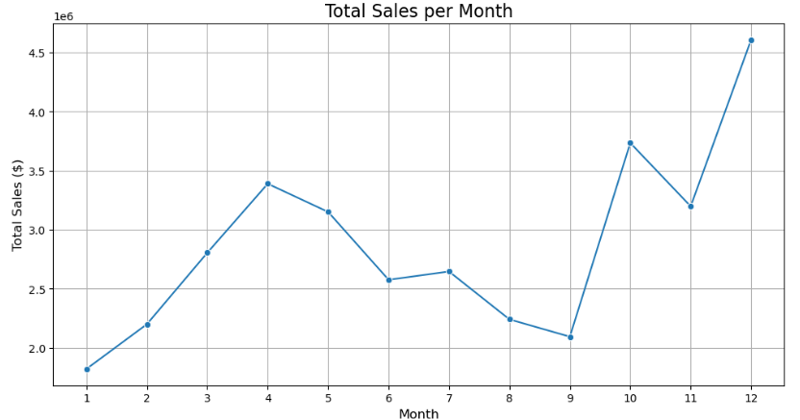
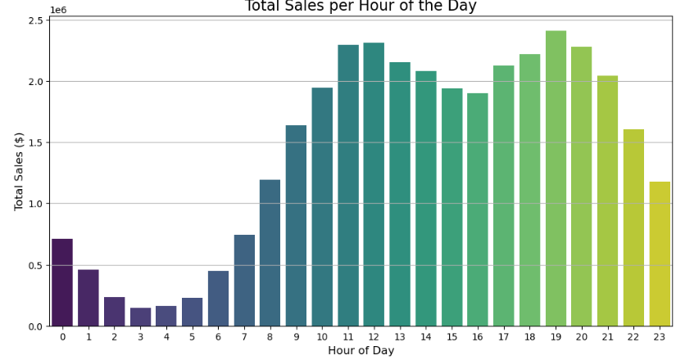
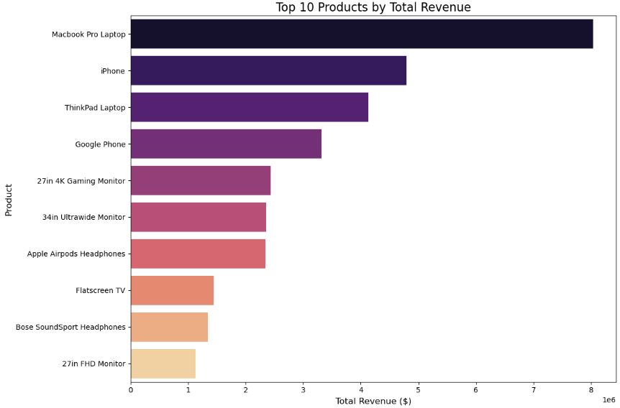
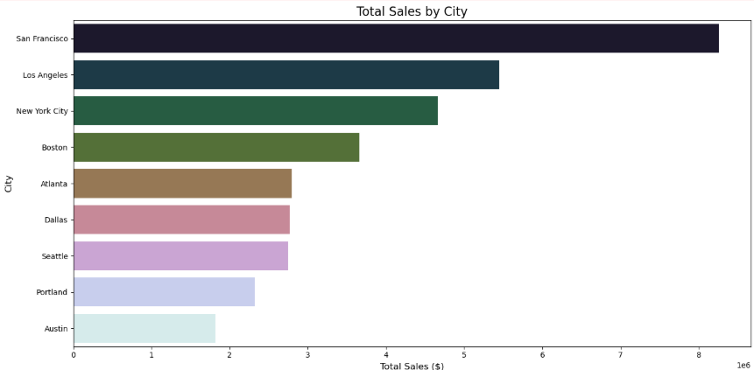
Exploratory Data Analysis (EDA)
Key Insights from Visualizations
Sales Over Time: Clear seasonal pattern with December peak.
Hourly Sales: Highest sales volumes around 12 PM and 7 PM.
Product Performance: Batteries sell high volume; Macbook Pro and iPhone generate high revenue.
Geographical Focus: San Francisco and Los Angeles are top markets.

Slide 5
SQL Analysis: High-Level Performance
Overall KPIs
Monthly Sales Trends
Data Views
Calculates total orders, total revenue, and average order value (AOV) for foundational business health.
Calculates month-over-month (MoM) revenue growth using LAG function to track momentum.
Creates a VIEW (vw_Ecommerce_KPIs) to easily query monthly KPIs without rewriting complex SQL.
SELECT COUNT(DISTINCT Order_ID) AS Total_Orders, SUM(Quantity_Ordered * Price_Each) AS Total_Revenue, AVG(Quantity_Ordered * Price_Each) AS Average_Order_Value

Slide 6
SQL Analysis: Granular Insights
Top Products
1
Identifies top 10 products by total revenue, highlighting biggest financial contributors.
Hourly Sales
2
Analyzes hourly sales patterns (DATEPART(HOUR, Order_Date)) for optimizing staffing and promotions.
Sales by City
3
Extracts city from address to calculate total revenue, orders, and AOV per city, identifying key markets.
Bundled Products
4
Identifies customers buying multiple products in one order using GROUP BY and STRING_AGG for cross-selling strategies.
Order Value Segmentation
5
Segments orders into high-value (> $2000) and low-value (< $2000) for targeted marketing.

Slide 7
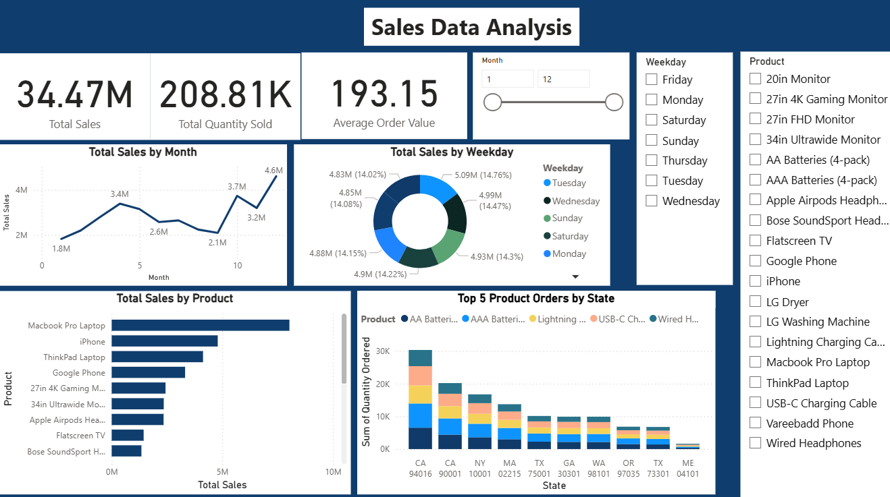
Power BI: Executive Summary & KPIs
Key Metrics
Total Sales: $34.47 Million
Total Quantity Sold: 208.81 Thousand
Average Order Value: $193.15
Chart Analysis
Total Sales by Month: Identifies seasonal patterns and impact of campaigns.
Total Sales by Weekday: Shows profitable days (Tuesday and Friday leading) for optimizing staffing and promotions.
Total Sales by Product: Macbook Pro Laptops are top-selling by revenue.
Top 5 Product Orders by State: Highlights regional product preferences.

Slide 8
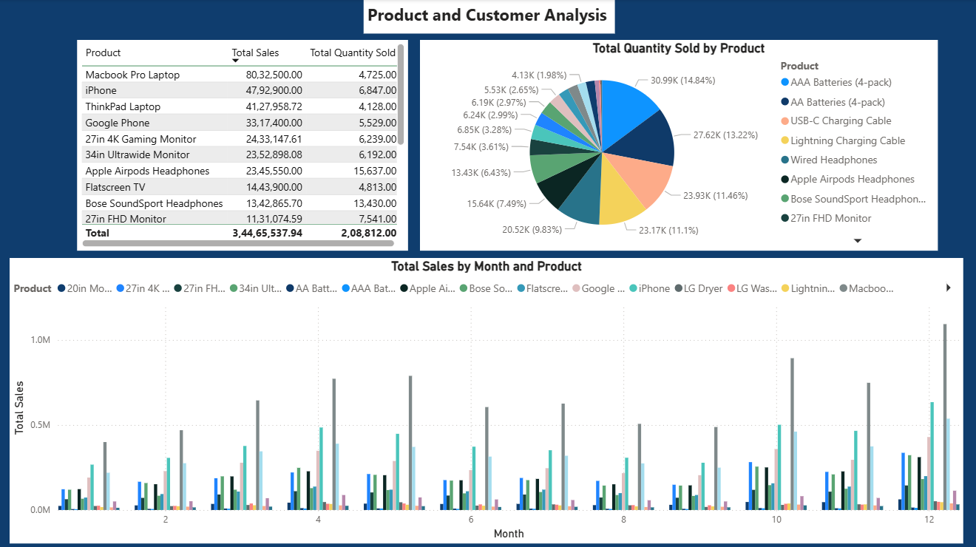
Power BI: Product & Customer Insights
Chart Analysis
Total Sales by Product: Identifies high-revenue items like Macbook Pro Laptop and iPhone for marketing focus.
Total Quantity Sold by Product: Shows popularity of items like AAA Batteries (4-pack) for inventory management.
Product Sales by Month : Compare product sales over time to identify seasonal trends.

Slide 9
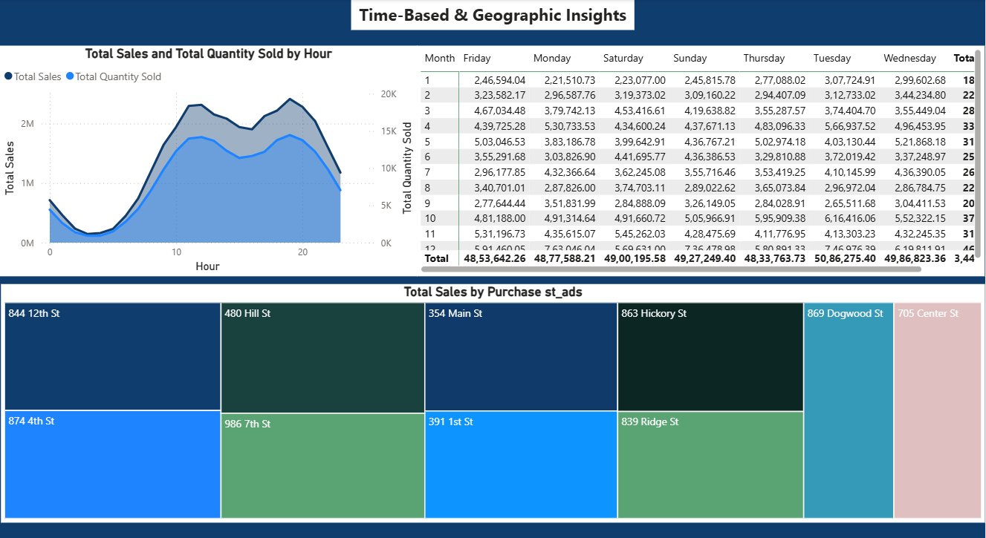
Power BI: Time & Location Performance
Chart Analysis
Total Sales & Quantity Sold by Hour: Pinpoints peak hours (late morning, late afternoon/early evening) for staffing and digital promotions.
Daily & Monthly Sales : A detailed table to show sales for each day of the week and month
Total Sales by Purchase Store Address: Identifies best-performing stores (e.g., 354 Main St, 986 7th St) and underperforming ones for operational improvements.

Slide 10
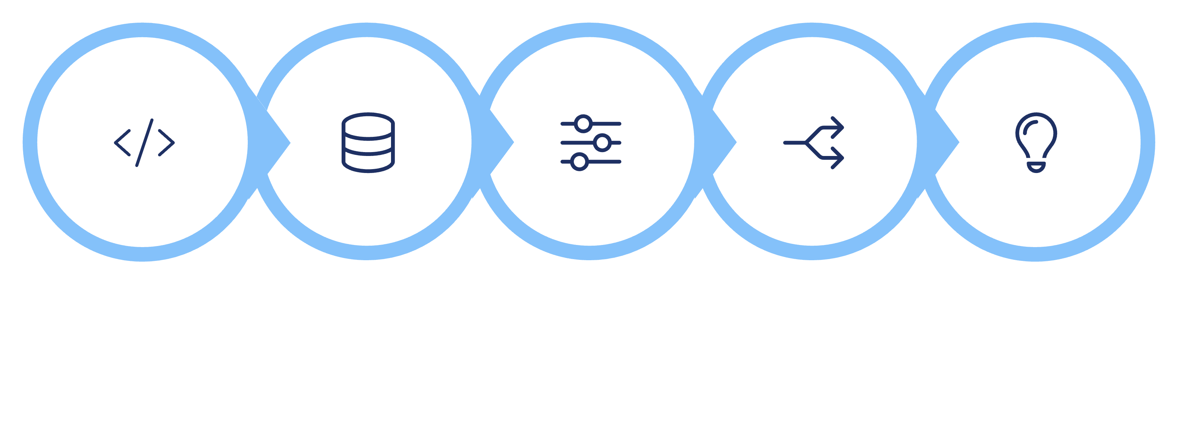





Machine Learning: Sales Forecasting
Library Imports
Define Features
Data Splitting
Training & Prediction
Data Loading
x , y
This Python workflow builds and evaluates a Linear Regression model to predict sales prices using quantity, price, and time-related data.

Slide 11
ML Workflow: Linear Regression for Sales Prediction
This Python code outlines a standard machine learning workflow to build and evaluate a Linear Regression model for predicting the Total Price of a sale, using features like Quantity Ordered, Price Each, Month, Day, and Hour.
1
Library Imports
Essential libraries like pandas, sklearn, and numpy are imported for data manipulation, model training, and evaluation.
2
Data Loading
The dataset is loaded from "combined11_sales_data.xlsx" into a pandas DataFrame.
3
Define Features & Target
Input features (X) and the target variable (y - 'Total Price') are defined for the model.
4
Data Splitting
Data is split into 80% training and 20% testing sets for model development and evaluation.
5
Training & Prediction
A Linear Regression model is initialized, trained on the training data, and then used to predict sales on the test data.
6
Model Evaluation
Key metrics like MSE, R-squared, and RMSE are calculated to assess model performance.

Slide 12
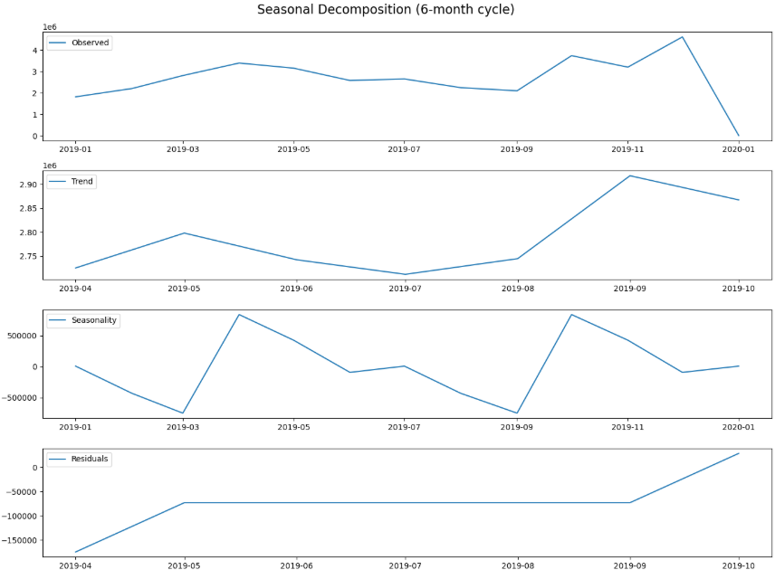
Forecasting Future Sales with Holt-Winters
Time Series Forecasting
Decomposing Sales Trends
Predicting future values based on past observations over time, crucial for inventory, marketing, and staffing.
1
Observed
Original sales data, including trends, seasonal patterns, and fluctuations.
2
Trend
Underlying direction of data over time, smoothing short-term ups and downs.
3
Seasonal
Recurring, predictable patterns repeating at regular intervals (e.g., monthly spikes).
4
Residual
Unexplained "noise" after trend and seasonal components are removed.

Slide 13
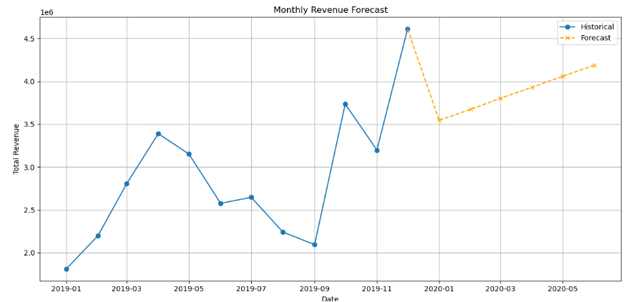




Forecasting with the Holt-Winters Model
1
2
Why Holt-Winters?
The Forecast
Ideal for time series data with both a trend (upward/downward movement) and a seasonal component (predictable spikes), both confirmed in our sales data.
A specialized statistical forecasting technique for time series data. It explicitly models and uses three key components:
Observed : The average value of the data.
Trend: The general increasing or decreasing direction.
Seasonality: Predictable, recurring patterns
(e.g., monthly sales spikes).
Ideal for our sales data due to its strong seasonal pattern
and overall upward trend.
Trained on historical data, the model predicts future sales with confidence, offering a valuable tool for business planning.
A specialized statistical forecasting technique for time series data. It explicitly models and uses three key components:
Historical Data
Trend & Seasonality
Holt-Winters
Forecasts

Slide 14

Strategic Recommendations for Growth
Marketing Strategy
Seasonal Campaigns: Launch major promotions in October and November to capitalize
on end-of-year sales spikes.
Targeted Ads: Focus advertising efforts during 12 PM and 7 PM peak hours for maximum
efficiency.
Inventory & Product Management
Prioritize Stock: Ensure high stock levels of Macbook Pro Laptops and iPhones to
meet peak demand.
Bundle Promotions: Create bundles (e.g., iPhone with Lightning Cable) to leverage accessory demand and boost high-priced product sales.
Geographical Focus
Concentrate Resources: Direct marketing and logistics towards San Francisco
and Los Angeles to build market share.

Slide 15
Thank You!
For more insights or questions, please reach out.

